Slide 1
EDF3622: Volunteer Placement Experience.
By Jayde Arnold

Slide 2
Knox Leisureworks – YMCA:
Knox/Boronia – A YMCA centre
Swimming pools, warm water pool/hydrotherapy, fitness classes, gym, physiotherapy and nutritionist on site.
Swimming lessons for fully abled and disabled (both private and public lessons available).
Access for all - Open Doors

Slide 3
Disability and Sport:
There are approximately four million Australian’s with disability, that’s 18.5 per cent of the entire population. That’s about one in five of us has a disability.
People with a disability should receive the same physical, mental, and social benefits from participating in sport and physical activity as those not having a disability. Under law, Australians of all abilities should have access to sport and physical activity opportunities.

Slide 4
Disability and Sport Cont:
Knox Leisureworks includes all individuals, creating opportunities for people of all abilities to participate. Whether participants choose to swim for fun, health or fitness; aspire to be a world champion; or choose to be involved in a non-swimming role such as a coach, official, or volunteer; a policy of inclusion helps to create opportunities.

Slide 5
Swimming with a Disability.

Slide 6
Disability
What kinds of disability are there?
What kinds of disability are suited to swimming?

Slide 7
Disability
What kinds of disability are there?
Persons with a disability include individuals with physical, sensory, intellectual, psychiatric, and/or other health related disabilities.
What kinds of disability are suited to swimming?
Swimming suits everyone’s ability.

Slide 8
What qualities sports coaches/practitioners need to have to work effectively with your group:
Qualifications
Caring
Patient
Passionate
Personable
Reliable
Make an effort to talk to a person and not just to a disability
Ready to try new ways
Thinking outside the box

Slide 9
How to integrate individuals with disability:
Get to know your participants
Build relationships
Understand that each individual has various reasons for their attendance
Use social workers and/or parents that you have access to, this could helping physically in the pool or just gaining additional information about the individual and their disability
Work to engage and have fun
Do not expect athletes
Introduce swimming skills later

Slide 10
How to integrate individuals with disability Cont:
The way we think about disability can create a barrier to participation. It is important to ensure we have a positive attitude. This will go a long way to ensuring inclusion.
When providing swimming opportunities we should put the person first and focus on what a swimmer can do, not on what they can’t do.
If we have the right attitude and provide an accessible and welcoming club environment then we are well on the way towards achieving inclusion.

Slide 11
TREE:
T = Teaching or coaching style
What can I modify about the way I am teaching/coaching?
Think about how your methods can make the most of the abilities within your group.
R = Rules and regulations
What can I modify in the rules or regulations?
Rules and regulations can be modified to ensure someone can participate.
E = Equipment
What can I modify about the equipment used in the session?
Changing or including equipment in a session may allow a swimmer to make the most of their abilities.
E = Environment
What can I modify about the environment to ensure no one is left out?
Think about where your swimmers are positioned in the pool or how easy it is to move around the pool deck.

Slide 12
When modifying any activity,
consider these points:
Keep the integrity of the activity intact
Keep the activity challenging, don’t make it too easy
Involve the participants in determining if and how to modify
Develop an understanding of fitness and work towards reducing the modifications over time as skill and understanding improve
Most importantly; only modify if and when you need to

Slide 13
Illustration of what types of activities are suitable when working with your group & why:
Very dependable on the
disability they have….
Can you name some possible swimming/water based activities?

Slide 14
Provide some practical examples of how sport coaches/practitioners may need to adapt activity to work with your group:

Slide 15
Scenario 1 – Sally
Sally is a good swimmer; she has tunnel vision and can see things up to one metre away. She has trouble timing her tumble turns and swimming straight in her lane. This can sometimes affect the other squad members during sessions as she bumps into them and slows them down. What can you do to ensure Sally’s inclusion does not disrupt the session?

Slide 16
Scenario 1 – Sally
Teaching or coaching style
Use clear audible instructions and ask Sally to confirm she understands.
Make up large print cue cards or diagrams.
Ask permission to physically manipulate Sally’s body in the desired technique on land first.
Adjust training time to allow one on one coaching.
Appoint a training buddy.
Rules and regulations
Allow Sally to swim up against the lane rope so she can feel her position in the lane.
Equipment
Erect distance markers on lane ropes or poolside.
Use fins to aid speed.
Use a tapper or audible cue as Sally approaches her turns.
Environment
Allocate Sally her own lane if possible or minimise lane sharing.

Slide 17
Scenario 2 – James
James is 7 years old and his parents have approached you to be his swimming teacher. James has Cerebral Palsy. He has full use of his arms and trunk and some leg function but has weakness and coordination problems on his left side. What can you do to make the most of his abilities and help him improve?

Slide 18
Scenario 3 – Tyler
Tyler is undertaking swimming lessons and will be moving to your class; he is 10 years old and he has a total hearing loss. What can you do to include Tyler in your program?

Slide 19
Scenario 4 – Erin
Erin is 4 years old and has just come into your class. Erin has joined a class with 3 other students. Erin has trouble concentrating for extended periods of time, and can become agitated in loud noisy environments. What modifications can you make to ensure you get the best out of Erin?

Slide 20
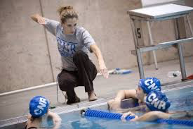
What might be some key issues/challenges faced when working with disabilities & how to overcome these?

Slide 21
Key issues/challenges faced when working with this group & how to overcome these:
Communication - Communicating with people with disability is no different to communicating with people without disability. It is important to listen to an individual and understand their needs. You should not assume or pre-judge so start by asking what the person can do and go from there.
Speak to the person, not their coach, friend or assistant.
Access to correct equipment
Modifying activities/being new and inventive
Multiple disabilities in one class

Slide 22
Videos:
https://www.youtube.com/watch?v=2BX0rTXiZyM
https://www.youtube.com/watch?v=pMbozDqdxJ0

Slide 23
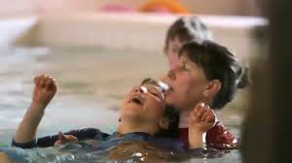
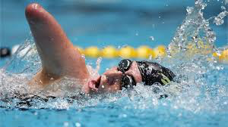
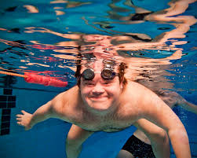
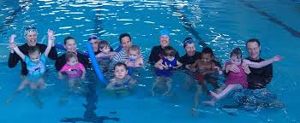
Access to Swimming, for All.

